Slide 1
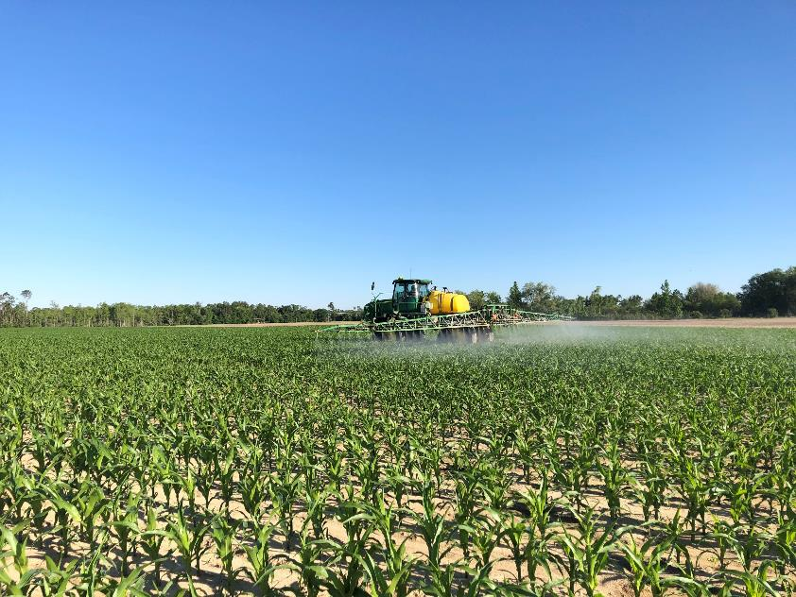

Weed Control in Field Corn 2025
Eric P. Prostko
Extension Weed Specialist
Dept. Crop & Soil Sciences

Slide 2
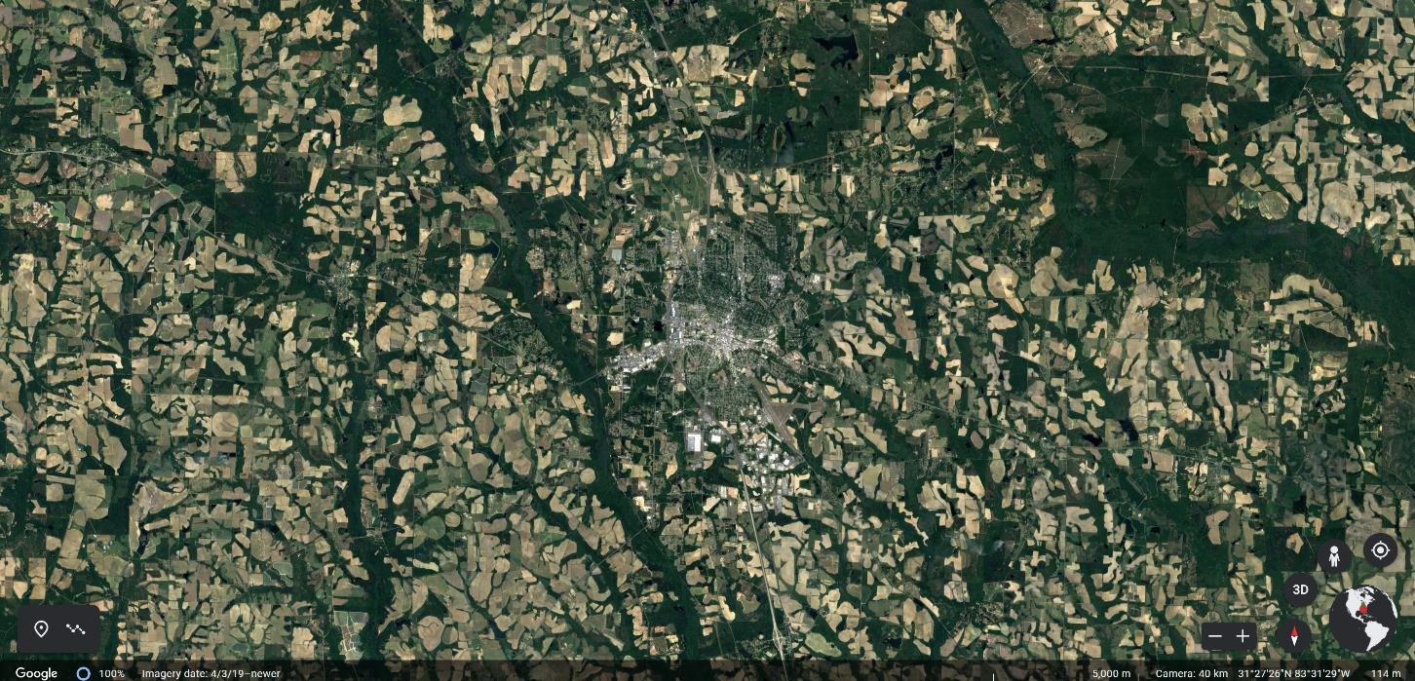
South Georgia Agriculture
Tifton
Coastal Plain Soils, high rainfall (47”/year), supplemental irrigation, soils never
freeze, crop diversity (peanut, cotton, soybean, corn, pecans, watermelons, onions,
blueberries, cantaloupes, peppers, tomatoes, collards, broccoli, peaches)

Slide 3
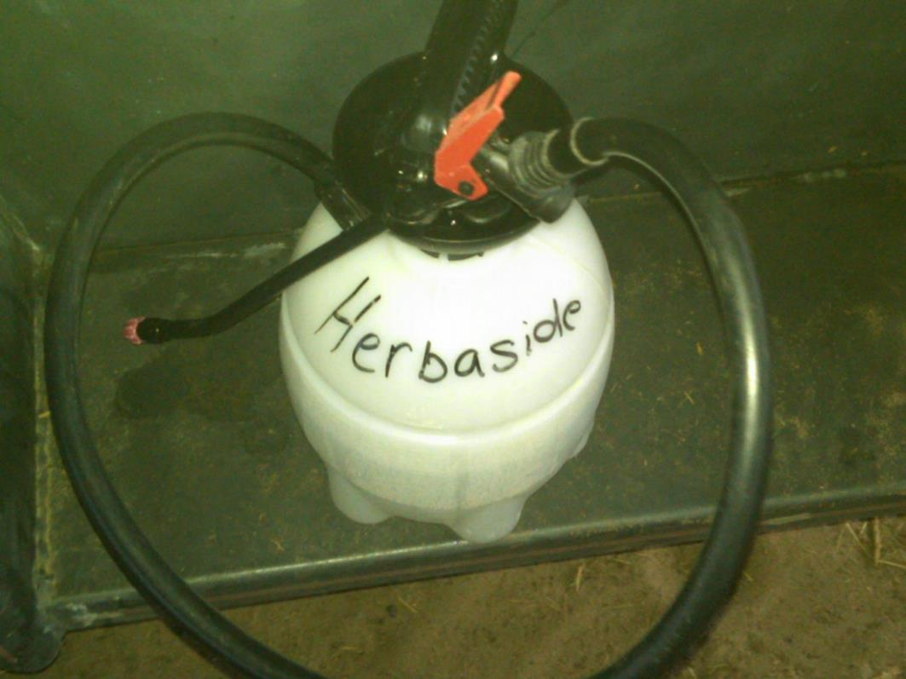
Problems

Slide 4
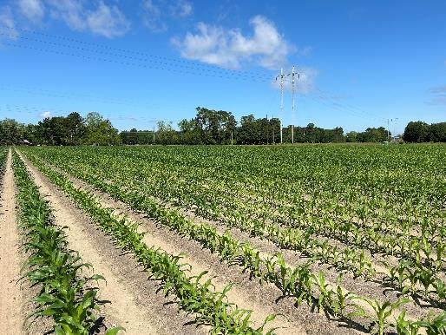
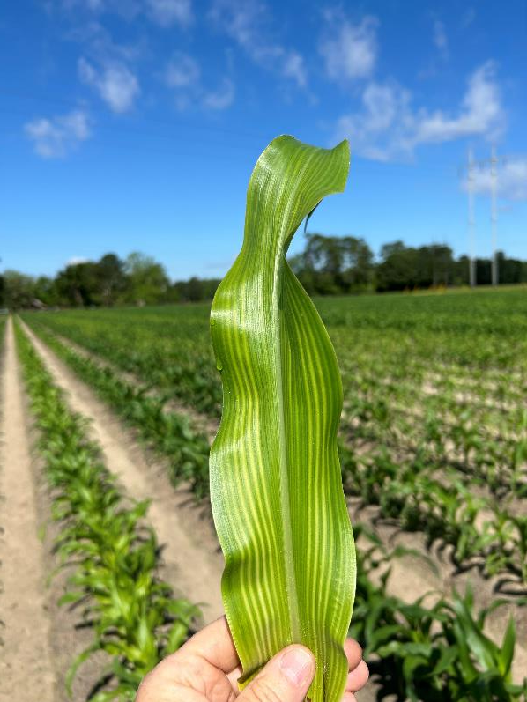
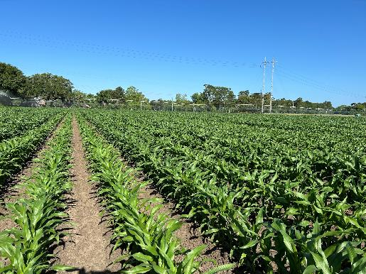
Herbicide Injury or ?????
Before
After 30 lbs S
T. Price
April 2024

Slide 5
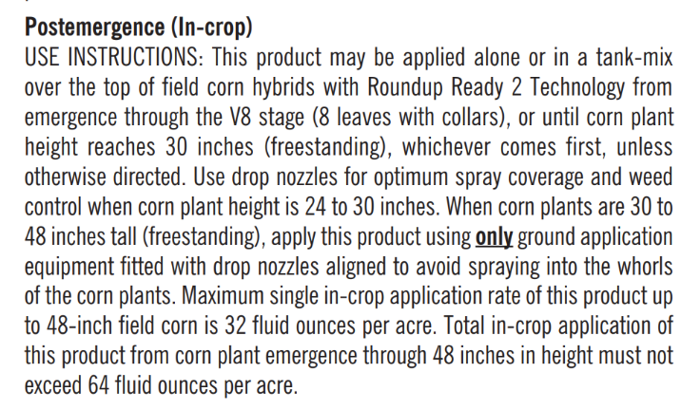
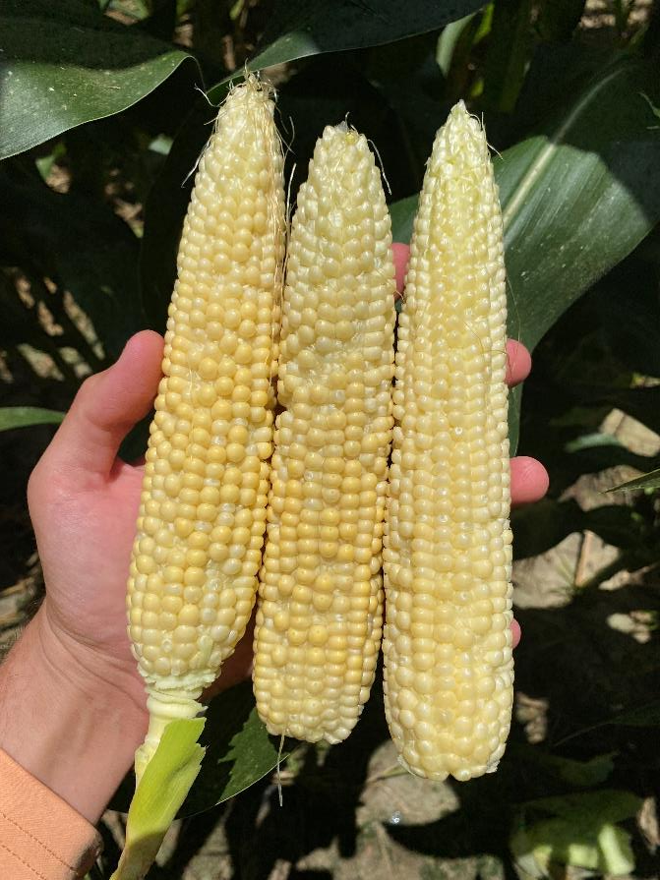
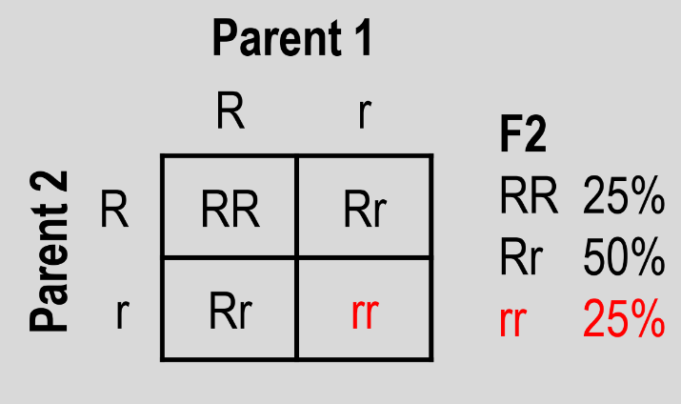
Glyphosate at Tassel Honcho K6 5.5SL @ 40 oz/A + Atrazine 4L @ 16 oz/A; P-1847, DKC-7045
C. Cloud
06/14/24
https://www.pioneer.com/CMRoot/Pioneer/US/Non_Searchable/agronomy/cropfocus_pdf/off_label_glyphosate_app_corn.pdf

Slide 6
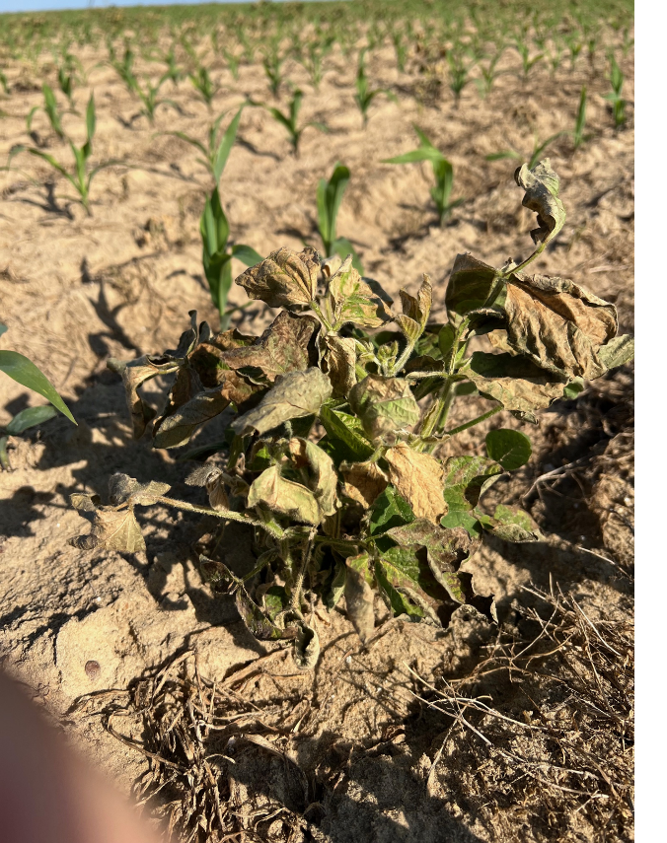
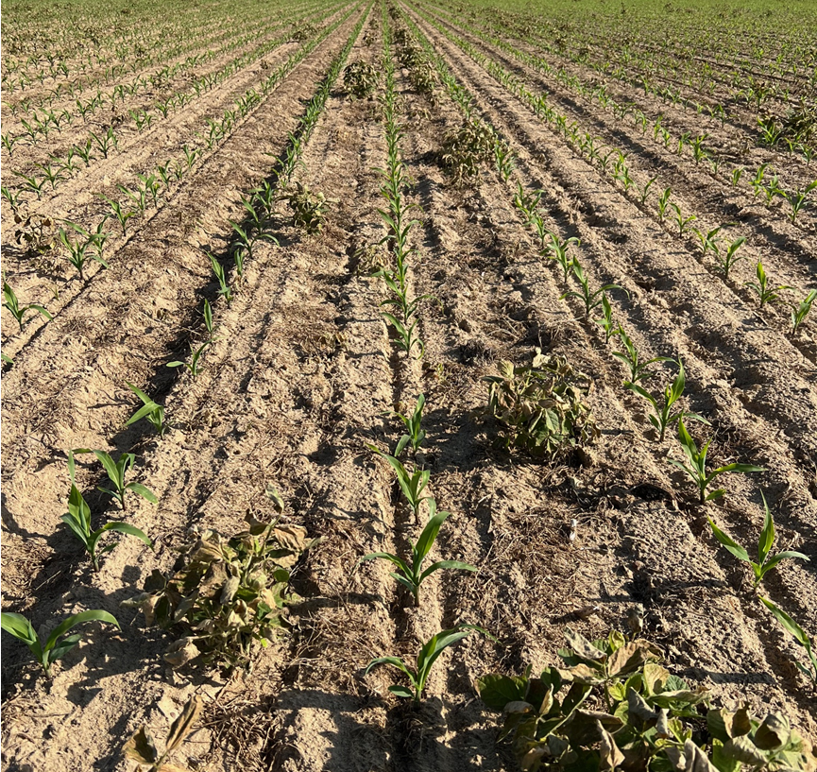
Volunteer Soybean (RR/Enlist) Control in Field Corn Roundup + Atrazine + Sandea
R. Ethredge
April 8
6 DAT

Slide 7
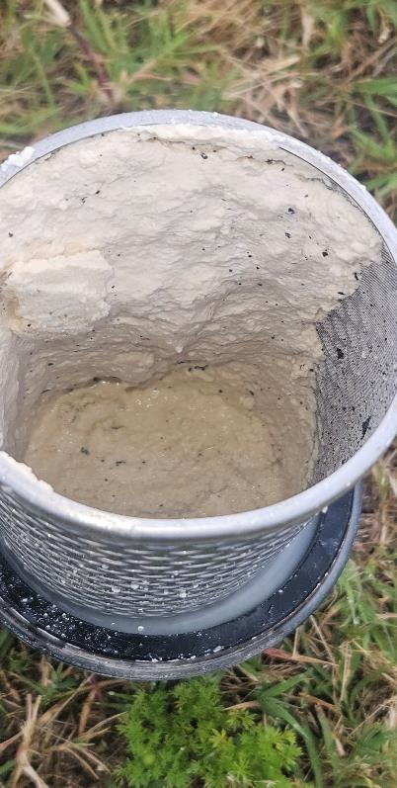
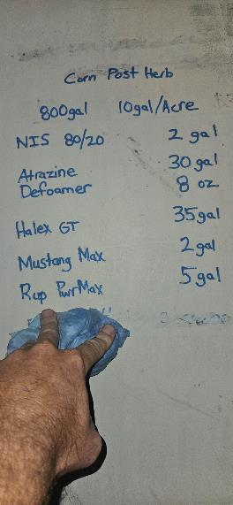
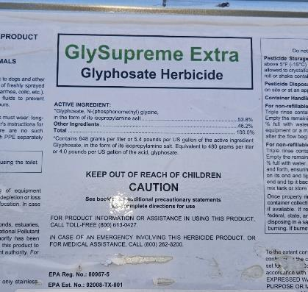
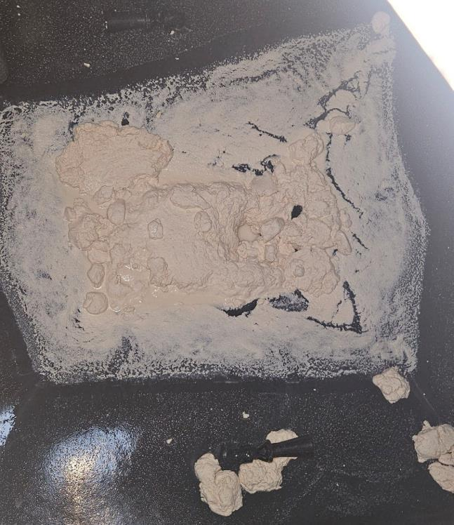
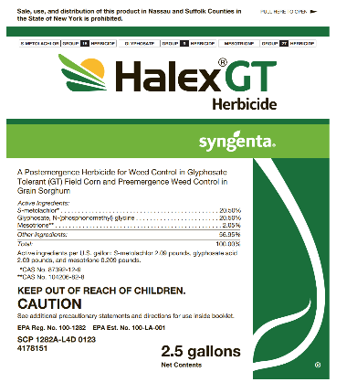
Halex GT + Atrazine with Glyphosate-IPA
Macon Co.
April 16, 2024

Slide 8
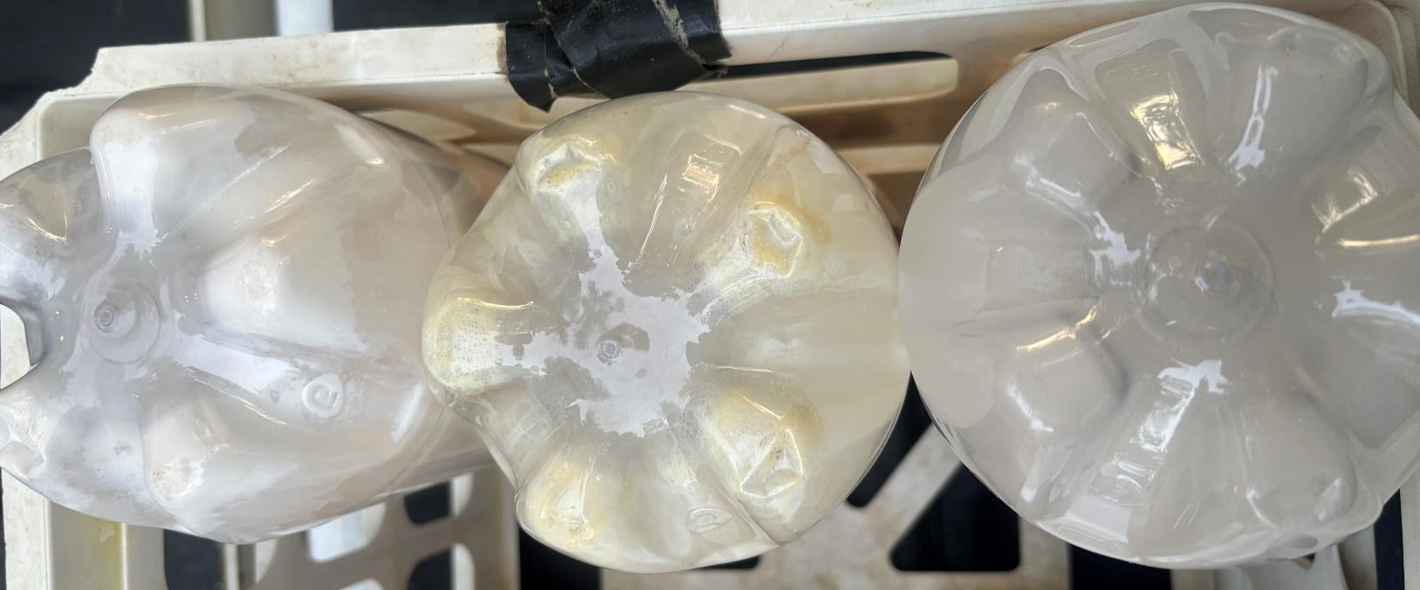
Halex GT + Atrazine with Different Glyphosate Formulations
Roundup PowerMax3
(K-salt)
Credit Extreme
(IPA + K-salt)
GlySupreme Extra
(IPA)
April 17, 2024
~24 Hours after mixing

Slide 9
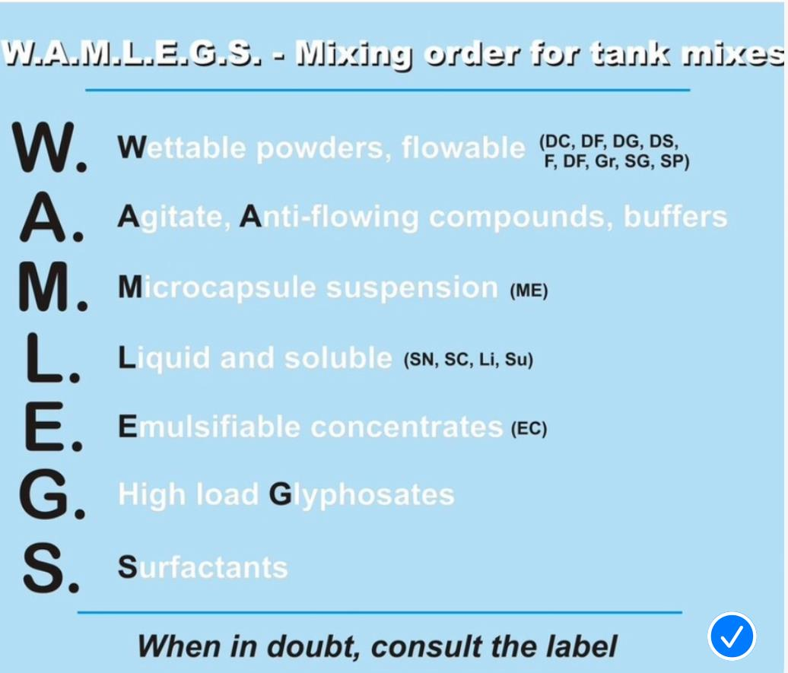
Tank-Mixing Order (for most but not all)

Slide 10
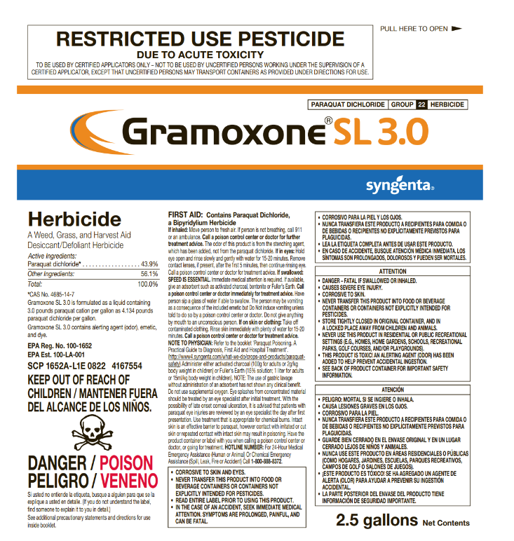
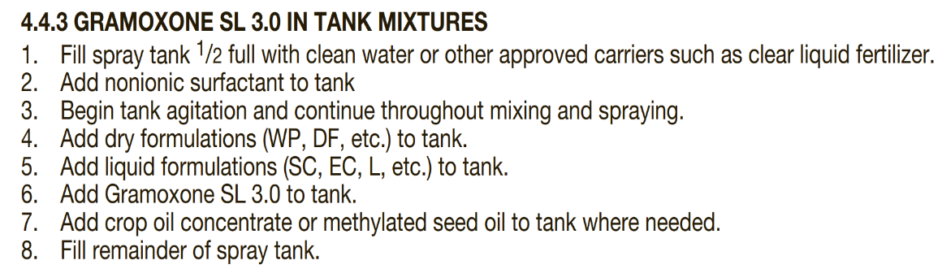
Gramoxone Tank-Mixing

Slide 11
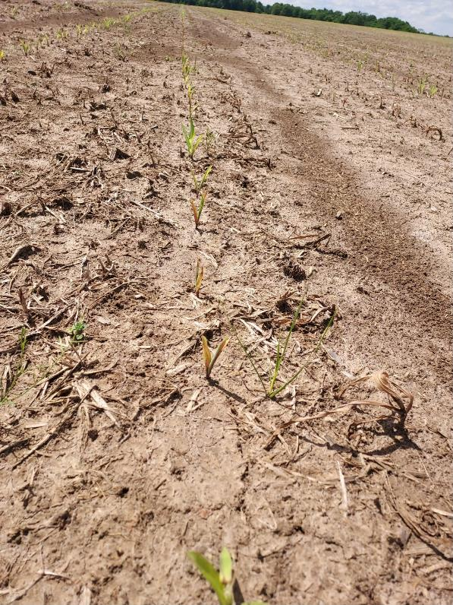
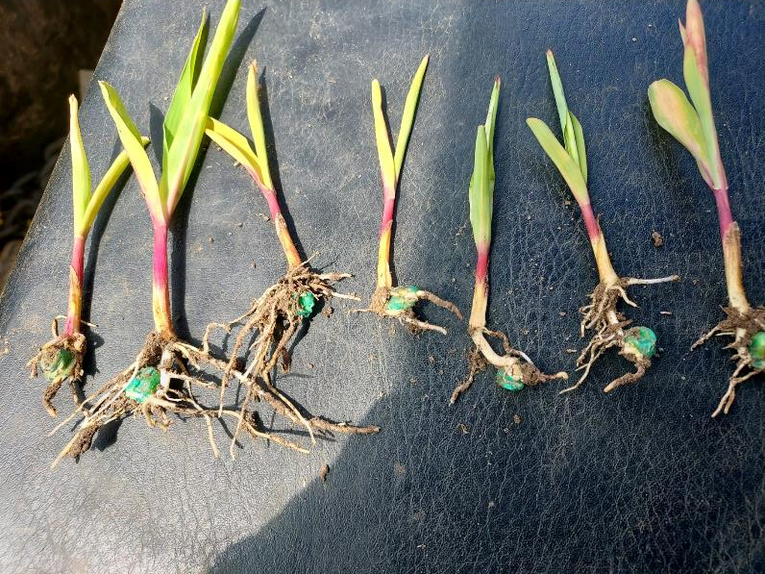
Clethodim 2EC @ 3 oz/A Applied the Day of Planting (oops!)
Macon Co.
April 22, 2024

Slide 12
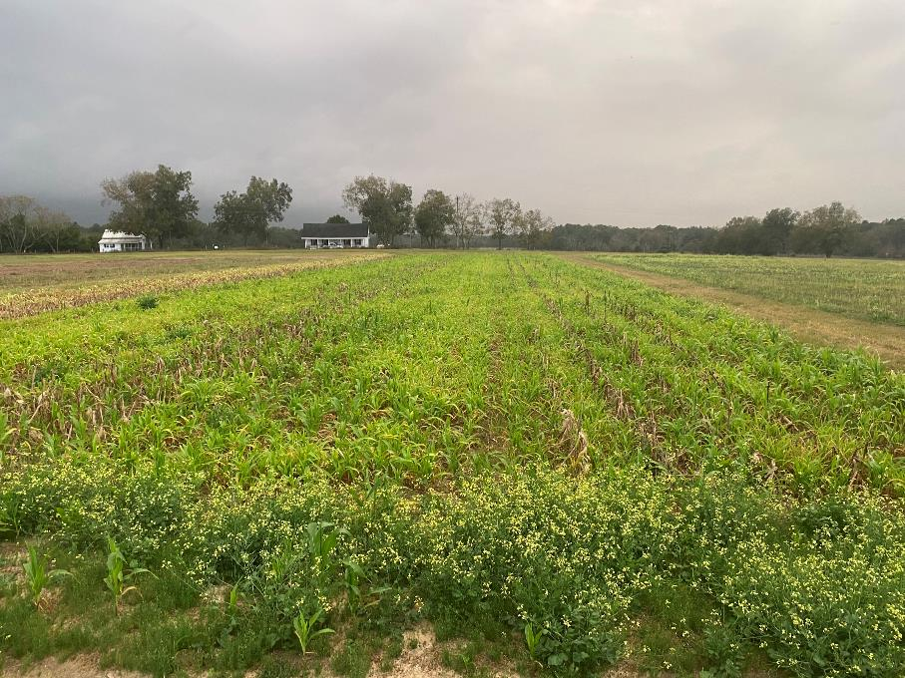
Volunteer/Replant Situations
most hybrids are RR or RR + LL
Options
Gramoxone (paraquat)
+ PSII Inhibitor (Atrazine or Metribuzin)????
Liberty (glufosinate)
Select (clethodim)
6 day plant-back
corn growing point below ground until ~V5 stage

Slide 13
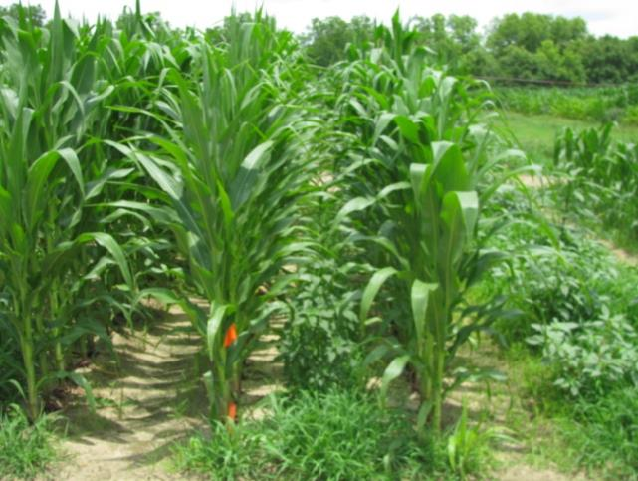
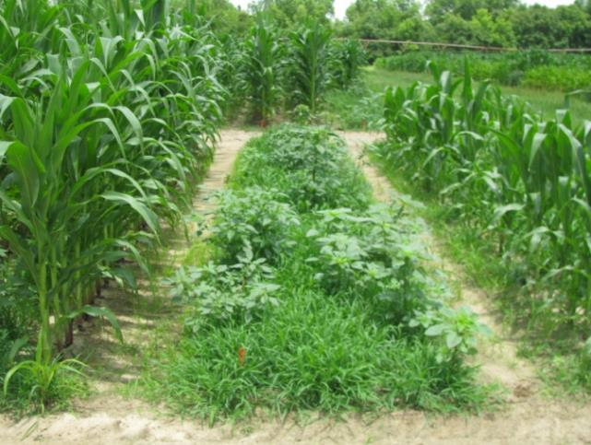
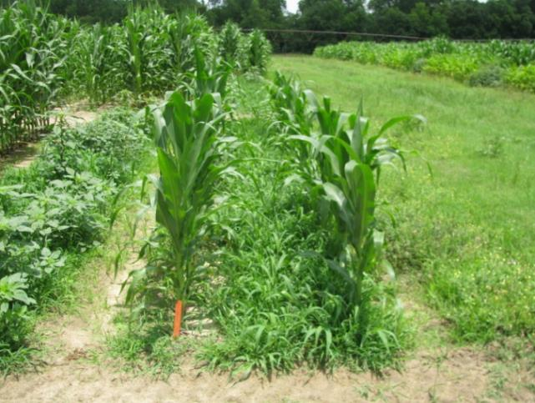
RR Corn Control (Pioneer 33M57) 40 DAT*
NTC
(123 Bu/A)
SelectMax 0.97EC @ 6 oz/A
Induce @ 0.25% v/v
AMS X-TRA @ 2.5% v/v
(0 Bu/A)
Gramoxone Inteon 2SL @ 40 oz/A
Atrazine 4L @ 32 oz/A
Agridex @ 1% v/v
(27 Bu/A)
*Applied to 7” tall corn, V4 stage of growth

Slide 14
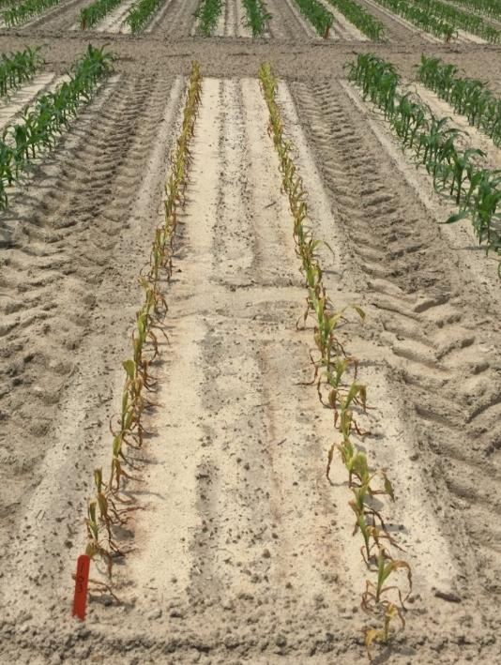
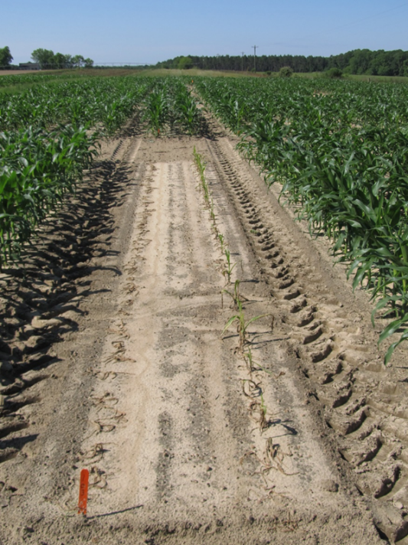
What happens when you spray Liberty on a non-LL corn hybrid?
CN-01B-16
DKC 66-59
Liberty @ 29 oz/A +
Atrazine @ 48 oz/A
Applied V4-V5 (6”)
*Only made 28 Bu/A!!!!!
*Other treatments made ~231 Bu/A
*88% yield loss
6 DAT
15 DAT

Slide 15
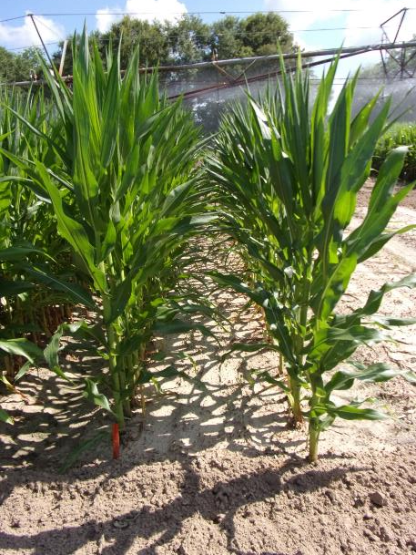
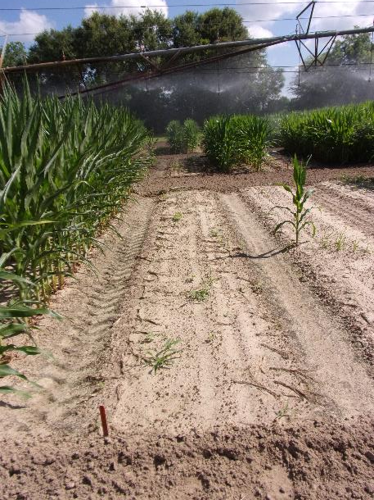
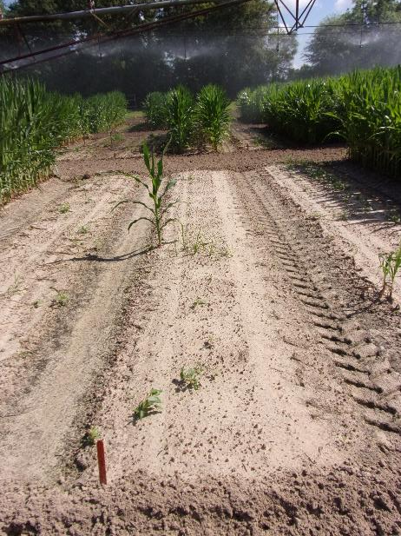
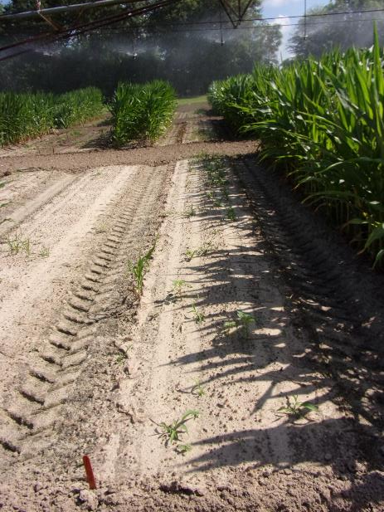
RR Field Corn (DKC-6835) Control for Replant – 2024 Applied 20 DAP (V5, 11” tall)
NTC
Select Max 0.97EC @ 6 oz/A
Induce @ 0.25% v/v
Gramoxone 3SL @ 32 oz/A
Induce @ 0.25% v/v
Liberty 2.34SL @ 32 oz/A
AMSOL @ 2% v/v
CN-08-24
June 7
23 DAT

Slide 16
Field Corn Yield Loss (%) Caused by Uncontrolled Weeds in UGA Weed Science Research Trials (2007-2024) Treated vs. Non-treated
200 Bu/A X 0.33 X $4.10 = $271/A
250 Bu/A X 0.33 X $4.10 = $338/A
What about harvest?
What about next year?

Slide 17



As always………
start clean
cover crops, tillage, herbicides
multiple residuals
Timely POST’s
Post-Harvest
“The Greatest American County Agent”

Slide 18
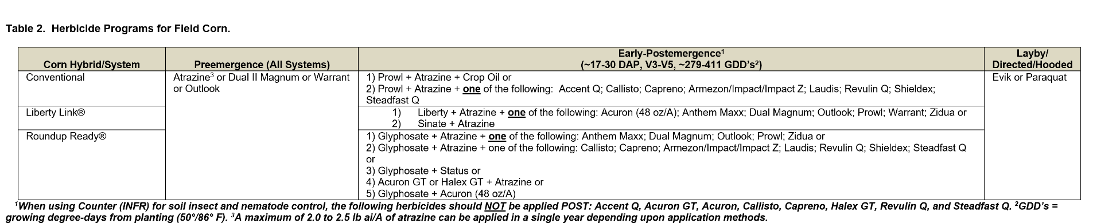
Field Corn Weed Control Programs

Slide 19
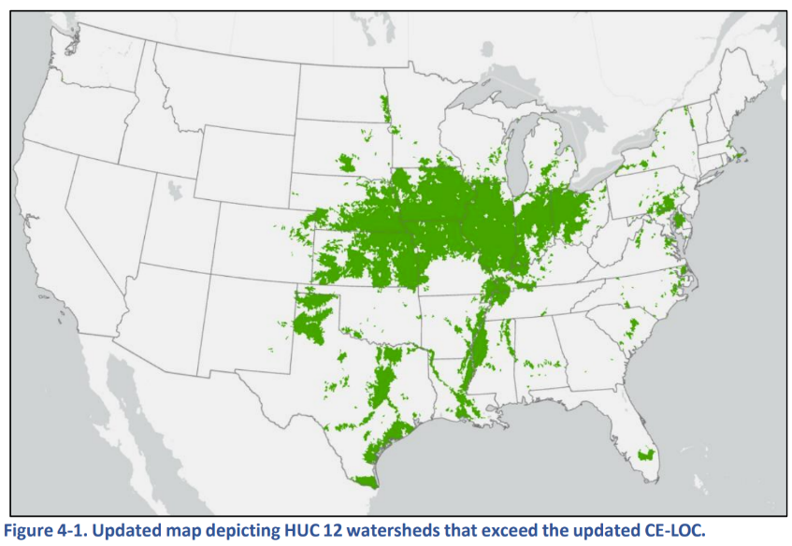
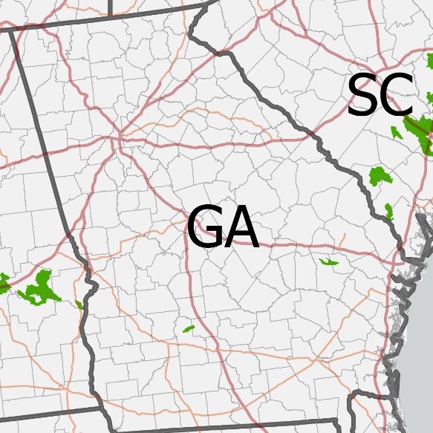
EPA Updates Atrazine CE-LOC to 9.7 µg/L (up from 3.4 µg/L) - July 8, 2024
2026?
Watersheds with higher predicted atrazine concentration are expected to have waterbodies with greater vulnerability to atrazine runoff due to landscape features (e.g., soil restrictive layers), precipitation, and atrazine usage.
Worth/Turner
Tattnall/Evans
CE-LOC = concentration-equivalent level of concern
HUC = hydrologic unit code

Slide 20
New(er) Products Being Tested - I Not in UGA Pest Control Handbook (yet?)
AMVAC
Sinate (glufosinate + topramezone)
Impact Core (topramezone + acetochlor)
BASF
Surtain (pyroxasulfone + saflufenacil)
Bayer
TriVolt (isoxaflutole + thiencarbazone + flufenacet)
Corteva
Kyro (encapsulated acetochlor + topramezone + clopyralid)
Resicore (mesotrione + acetochlor + clopyralid)
Resicore XL (mesotrione + encapsulated acetochlor + clopyralid)
Syngenta
Acuron GT (bicyclopyrone + s-metolachlor + mesotrione + glyphosate)
Acuron XR (bicyclopyrone + s-metolachlor + mesotrione + atrazine)
Storen (s-metolachlor + mesotrione + bicyclopyrone + pyroxasulfone)

Slide 21
New(er) Products Being Tested - II Not in UGA Pest Control Handbook (yet?)
Helm
Katagon (tolpyralate + nicosulfuron)
Helmet Maxx (metolachlor + atrazine + mesotrione)
Helena
Empyros (tolpyralate + s-metolachlor)
Empyros Triad (tolpyralate + s-metolachlor + atrazine)
Empyros Triad Flex (tolpyralate + s-metolachlor + atrazine)
Valent
Maverick (mesotrione + pyroxasulfone + clopyralid)
Summit Agro
Restraint (tolpyralate + acetochlor + dichlormid)

Slide 22
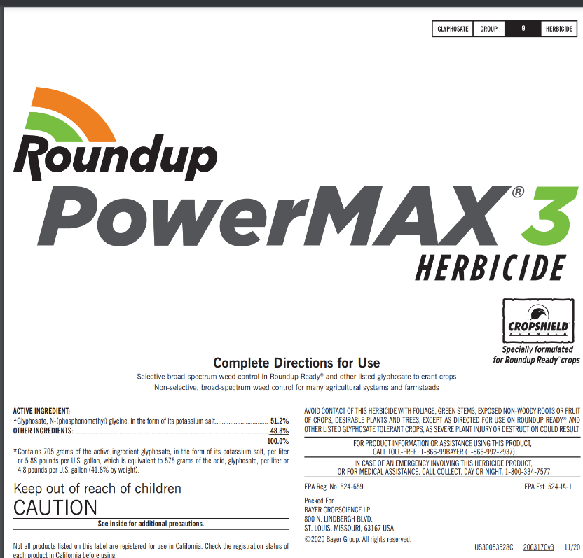
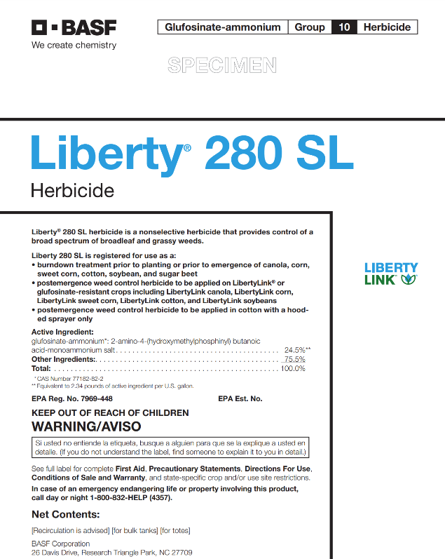
Roundup + Liberty Rates?

Slide 23
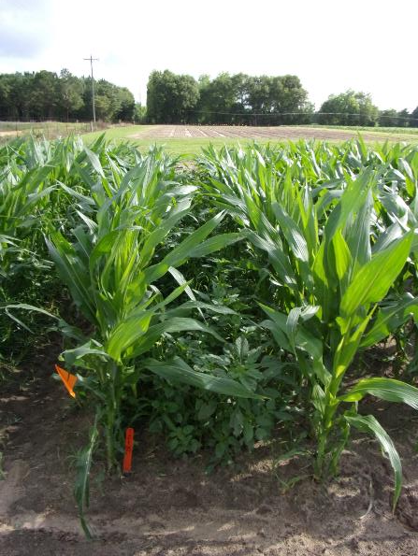
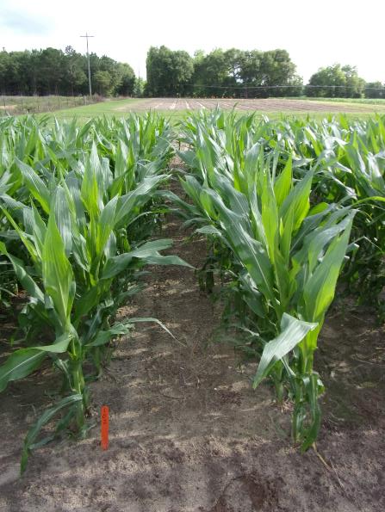
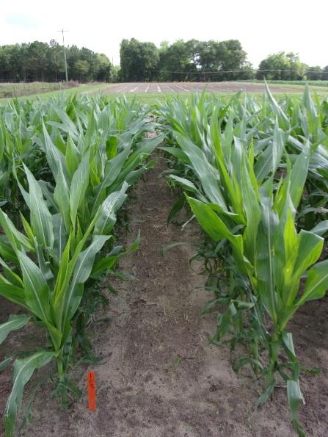
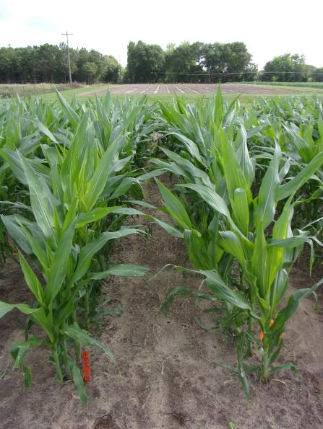
Weed Control In Field Corn with Roundup + Liberty - 2024
NTC
Roundup P-Max3 5.88SL @ 22 oz/A
Liberty 2.34SL @ 22 oz/A
Aatrex 4L @ 64 oz/A
Prowl H₂O 3.8SC @ 32 oz/A
Applied POST (24 DAP)
Roundup P-Max3 5.88SL @ 27 oz/A
Liberty 2.34SL @ 27 oz/A
Aatrex 4L @ 64 oz/A
Prowl H₂O 3.8SC @ 32 oz/A
Applied POST (24 DAP)
Roundup P-Max3 5.88SL @ 32 oz/A
Liberty 2.34SL @ 32 oz/A
Aatrex 4L @ 64 oz/A
Prowl H₂O 3.8SC @ 32 oz/A
Applied POST (24 DAP)
CN-07-24
May 15
20 DAT

Slide 24
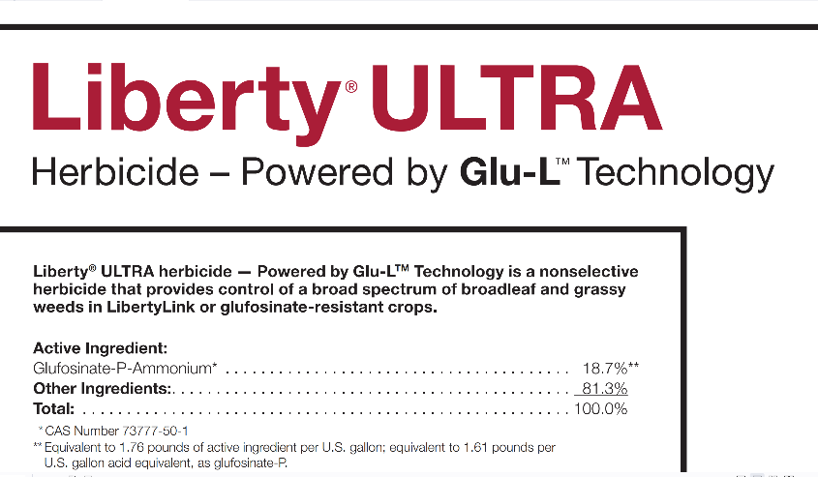
Liberty® ULTRA 1.76SL
BASF
glufosinate-P-ammonium
More active isomer
Dual vs. Dual Magnum
Metolachlor vs. S-metolachlor
lower use rate (19-29 oz/A)
Mandatory downwind spray buffer
ground = 10’/aerial = 50’
3 points for ESA runoff/erosion
Tift Co. = 2 points
sandy soils = 2 points

Slide 25
Conventional Field Corn
Dual, Warrant, Outlook (PRE)
Callisto, Laudis, Shieldex, Revulin Q, Steadfast Q (POST)
+ Atrazine (64 oz/A) + Prowl (32 oz/A)
Anthem Maxx, Dual, Warrant, Outlook, Zidua if you don’t like/want/Prowl but………..
adjuvant as needed/required

Slide 26

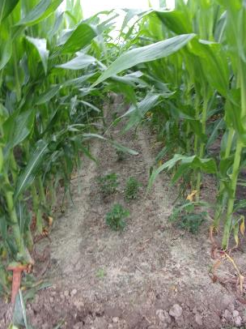
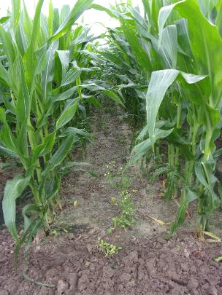
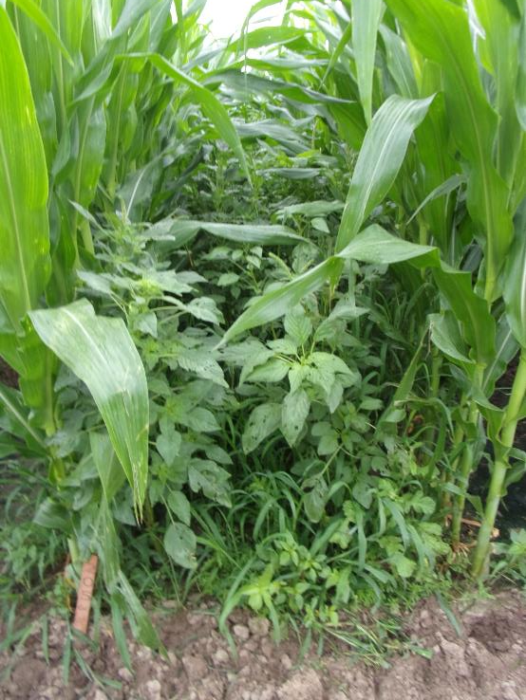
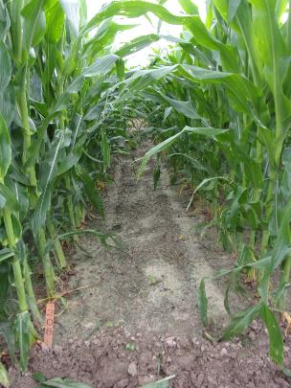
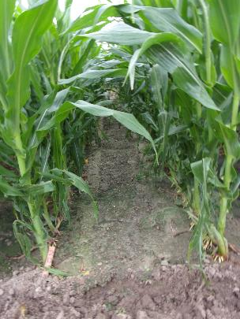
Weed Control in Field Corn with No Roundup, Liberty, or Atrazine - 2024
Dual II Magnum 7.62EC @ 16 oz/A
PRE
Callisto 4SC @ 3 oz/A
Prowl H₂0 3.8SC @ 32 oz/A
Induce @ 0.25% v/v
POST (28 DAP)
Dual II Magnum 7.62EC @ 16 oz/A
PRE
Laudis 3.5SC @ 3 oz/A
Prowl H₂0 3.8SC @ 32 oz/A
Induce @ 0.25% v/v
POST (28 DAP)
Dual II Magnum 7.62EC @ 16 oz/A
PRE
Impact 2.8SC @ 1.25 oz/A
Prowl H₂0 3.8SC @ 32 oz/A
Induce @ 0.25% v/v
POST (28 DAP)
Dual II Magnum 7.62EC @ 16 oz/A
PRE
Shieldex 3.33SC @ 1.35 oz/A
Prowl H₂0 3.8SC @ 32 oz/A
Induce @ 0.25% v/v
POST (28 DAP)
NTC
CN-01-24
May 23
52 DAP

Slide 27
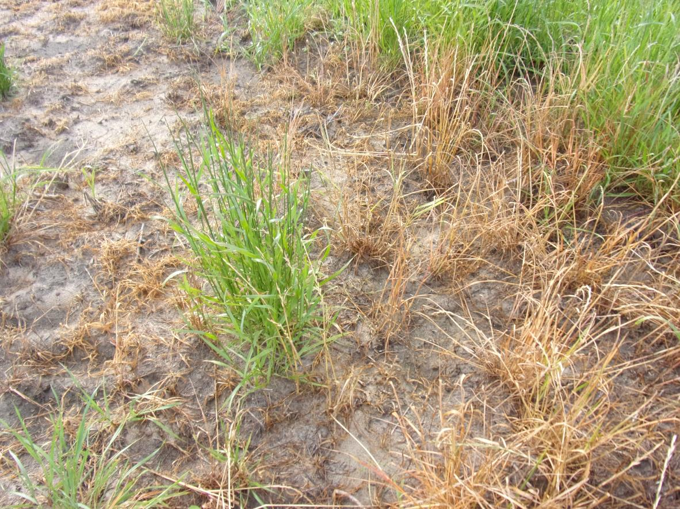
GR-Resistant Ryegrass?
Grady Co.
March 13, 2024

Slide 28
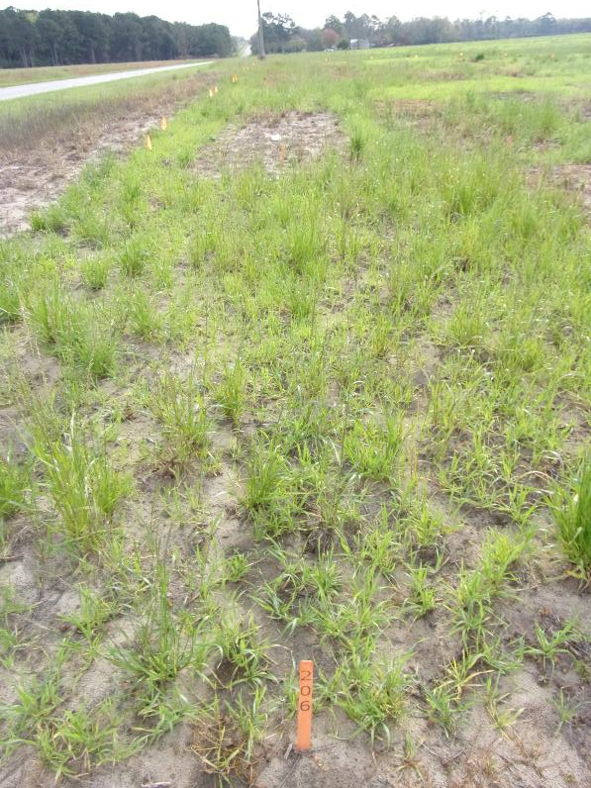
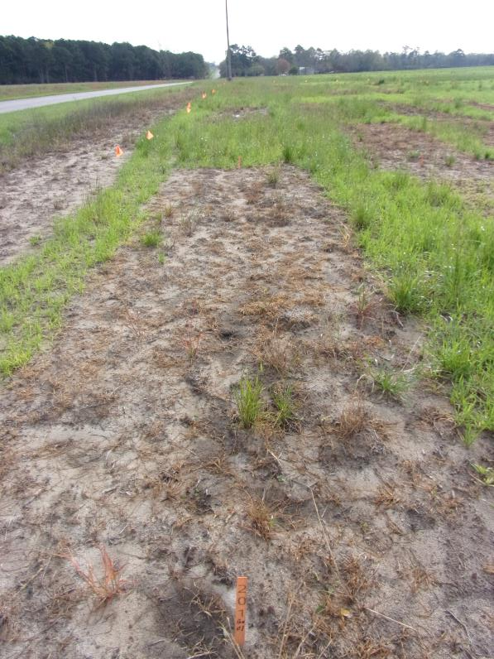
Burndown Control of Wheat/Ryegrass - 2024
NTC
Roundup PowerMax3 5.55SL @ 25 oz/A
AMSOL @ 2% v/v
BN-01-24
March 13
22 DAT

Slide 29
Annual Ryegrass Control with Roundup WeatherMax 5.5SL
Source: Lins et al. 2007. Weed Technology 21:602-605

Slide 30

Burndown Control of Wheat/Ryegrass - 2024
NTC
Gramoxone 3SL @ 32 oz/A
Aatrex 4L @ 32 oz/A
Induce @0.25% v/v
BN-01-24
March 13
22 DAT

Slide 31


Pre-Plant Burndowns
NTC
Helmquat 3SL @ 32 oz/A
Aatrex 4L @ 32 oz/A
Induce @ 0.25% v/v
CN-02-24
April 10
20 DAT

Slide 32

Post-Harvest Benghal Dayflower Test - 2024
Grady Co.
09/10/24

Slide 33



Post-Harvest Tropical Spiderwort Control – 2024 COMBE: 12-16” tall; flowering; POST1 = 09/10/24; POST2= 09/17/24
NTC
Gramoxone 3SL @ 32 oz/A
Induce @ 0.25% v/v
POST1 + POST2
Roundup P-MAX3 5.88 SL @ 32 oz/A
Enlist One 3.8SL @ 24 oz/A
POST1 + POST2
PH-01A-24
October 2
15 DAT (POST2)

Slide 34


Post-Harvest Tropical Spiderwort Control – 2024 COMBE: 12-16” tall; flowering; POST1 = 09/10/24; POST2= 09/17/24
NTC
Roundup P-MAX3 5.88 SL @ 32 oz/A
Aim 2EC @ 1.5 oz/A
POST1 + POST2
Roundup P-MAX3 5.88 SL @ 32 oz/A
Reviton 2.83SC @ 1.5 oz/A
POST1 + POST2
PH-01A-24
October 2
15 DAT (POST2)

Slide 35


A Must Have for GA Growers?
You don’t love America if you don’t have a lay-by rig!

Slide 36


Are you satisfied with your weed control? Do you want/need better spray coverage?
Think about ……
tractor speed
boom height
water volume
droplet size

Slide 37

Questions/Comments

